Slide 1
CSE221
Structure and Interpretation of
Computer Programs
Substitution Model for Procedure Application

Slide 2
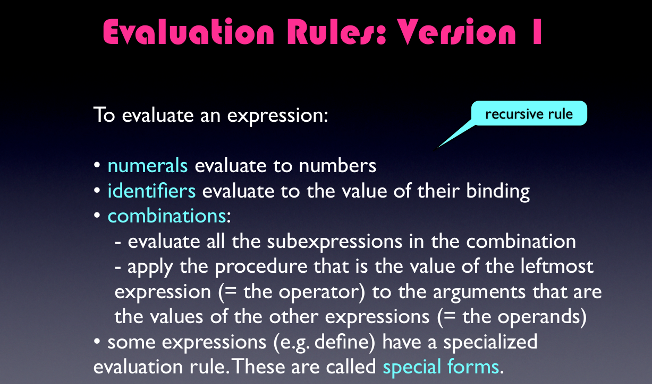

Slide 3
Substitution Model
(define (f a)
(sum-of-squares (+ a 1) (* a 2)))
(define (sum-of-squares x y)
(+ (square x) (square y)))

Slide 4
Substitution Model
(define (f a)
(sum-of-squares (+ a 1) (* a 2)))
(define (sum-of-squares x y)
(+ (square x) (square y)))
(f 5)

Slide 5
Applicative-order Evaluation
(f 5)

Slide 6
Applicative-order Evaluation
(f 5)
(sum-of-squares (+ a 1) (* a 2)))

Slide 7
Applicative-order Evaluation
(f 5)
(sum-of-squares (+ a 1) (* a 2)))
(sum-of-squares (+ 5 1) (* 5 2)))

Slide 8
Applicative-order Evaluation
(f 5)
(sum-of-squares (+ a 1) (* a 2)))
(sum-of-squares (+ 5 1) (* 5 2)))
(+ (square 6) (square 10))

Slide 9
Applicative-order Evaluation
(f 5)
(sum-of-squares (+ a 1) (* a 2)))
(sum-of-squares (+ 5 1) (* 5 2)))
(+ (square 6) (square 10))
(+ (* 6 6) (* 10 10))

Slide 10
Applicative-order Evaluation
(f 5)
(sum-of-squares (+ a 1) (* a 2)))
(sum-of-squares (+ 5 1) (* 5 2)))
(+ (square 6) (square 10))
(+ (* 6 6) (* 10 10))
(+ 36 100 )

Slide 11
Normal-order Evaluation
(f 5)

Slide 12
Normal-order Evaluation
(f 5)
(sum-of-squares (+ a 1) (* a 2)))

Slide 13
Normal-order Evaluation
(f 5)
(sum-of-squares (+ a 1) (* a 2)))
(sum-of-squares (+ 5 1) (* 5 2)))

Slide 14
Normal-order Evaluation
(f 5)
(sum-of-squares (+ a 1) (* a 2)))
(sum-of-squares (+ 5 1) (* 5 2)))
(+ (square (+ 5 1)) (square (* 5 2)))

Slide 15
Normal-order Evaluation
(f 5)
(sum-of-squares (+ a 1) (* a 2)))
(sum-of-squares (+ 5 1) (* 5 2)))
(+ (square (+ 5 1)) (square (* 5 2)))
(+ (* (+ 5 1) (+ 5 1)) (* (* 5 2) (* 5 2)))

Slide 16
Normal-order Evaluation
(f 5)
(sum-of-squares (+ a 1) (* a 2)))
(sum-of-squares (+ 5 1) (* 5 2)))
(+ (square (+ 5 1)) (square (* 5 2)))
(+ (* (+ 5 1) (+ 5 1)) (* (* 5 2) (* 5 2)))
(+ (* 6 6) (* 10 10))

Slide 17
Normal-order Evaluation
(f 5)
(sum-of-squares (+ a 1) (* a 2)))
(sum-of-squares (+ 5 1) (* 5 2)))
(+ (square (+ 5 1)) (square (* 5 2)))
(+ (* (+ 5 1) (+ 5 1)) (* (* 5 2) (* 5 2)))
(+ (* 6 6) (* 10 10))
(+ 36 100) = 136

Slide 18
Same result but different
processes

Slide 19
Same result but different
processes
Evaluate the arguments and then apply
Fully expand and then reduce

Slide 20
Scheme uses
applicative-order
evaluation

Slide 21
Scheme uses
applicative-order
Evaluation
Additional efficiency
Normal-order evaluation becomes
complicated outside procedures

Slide 22
Normal vs Applicative-Order
(define (p) (p))
(define (test x y)
(if (= x 0) 0 y))
(test 0 (p))

Slide 23
Normal Order
(test 0 (p))

Slide 24
Normal Order
(test 0 (p))
(if (= x 0) 0 (p))

Slide 25
Normal Order
(test 0 (p))
(if (= 0 0) 0 (p))
(if #t 0 (p))

Slide 26
Normal Order
(test 0 (p))
(if (= 0 0) 0 (p))
(if #t 0 (p))
0

Slide 27
Applicative-Order
(test 0 (p))

Slide 28
Applicative-Order
(test 0 (p))
(test 0 (p))

Slide 29
Applicative-Order
(test 0 (p))
(test 0 (p))
(test 0 (p))

Slide 30
More Examples
Given the following definitions of plus, double, divide, average, show the process evolution of applicative and normal orders of evaluation for the expression: (double (average 2 4))
(define (plus x y) (+ x y))
(define (double x) (plus x x))
(define (divide x y) (/ x y))
(define (average x y)(divide (plus x y) 2))

Slide 31
Solution – Applicative Order
(double (average 2 4))
(double (divide (plus 2 4) 2))
(double (divide (+ 2 4) 2))
(double (divide 6 2) )
(double (/ 6 2) )
(double 3)
(plus 3 3)
(+ 3 3)
6

Slide 32
Solution – Normal Order
(double (average 2 4))
(plus (average 2 4) (average 2 4))
(plus (divide (plus 2 4) 2) (divide (plus 2 4) 2) )
(plus (divide (+ 2 4) 2) (divide (+ 2 4) 2) )
(plus (/ (+ 2 4) 2) (/ (+ 2 4) 2) )
(+ (/ (+ 2 4) 2) (/ (+ 2 4) 2) )
(+ (/ 6 2) (/ 6 2) )
(+ 3 3)
6

Slide 33
More Examples
Given the definition of the procedures less, plus and divide as follows:
(define (less x y) (if (< x y) x y))
(define (plus x y) (+ x y))
(define (divide x y) (/ x y))
Evaluate the given expression using applicative and normal order evaluation: (if (less 3 4) (plus 5 5) (divide 1 0)) . Will you get the same result from both?

Slide 34
Solution – Applicative Order
(if (less 3 4) (plus 5 5) (divide 1 0))
(if (if (< 3 4) 3 4) (plus 5 5) (divide 1 0))
(if 3 (plus 5 5) (divide 1 0))
(plus 5 5)
(+ 5 5)
10

Slide 35
Solution – Normal Order
(if (less 3 4) (plus 5 5) (divide 1 0))
(if (if (< 3 4) 3 4) (+ 5 5) (/ 1 0))
(if 3 (+ 5 5) (/ 1 0))
(if 3 10 (/ 1 0))
(if 3 10 (Error — Divide by Zero))

Slide 36
Try it yourself
Evaluate (square(random(x)) using applicative and normal order evaluation. Will you get the same result from both?
Consider a magical function count that takes in no arguments, and each time it is invoked, returns one more than it did before, starting with 1. Therefore, (+ (count) (count)) will return 3. Evaluate (square(square(count))) using both applicative and normal order of evaluation, record your observations and justify the result obtained.

Slide 37
Thank you

